Slide 1
Introduction to Python
Class #4 –Loops – While / For

Slide 2
Code repetition
function : a block of code grouped under a name
loops: repeating a series of code (a) for a set number of times, or (b) until a condition is met

Slide 3
while

Slide 4
While
n = 1
while n < 10:
print(n)
n = n + 1

Slide 5
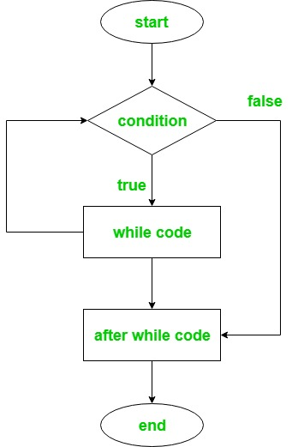
n = 1
while n < 10:
print(n)
n = n + 1
print(‘Goodbye.’)

Slide 6
While
n = 1
while n <= 5:
print(n)
n = n + 1

Slide 7
How does the loop unfold?
Iteration # | Value of n at start | Condition (n <= 5) | Output | Value of n at end
1 | 1 | True | 1 | 2
2 | 2 | True | 2 | 3
3 | ? | ? | ? | ?
4 | ? | ? | ? | ?
5 | ? | ? | ? | ?
11 | 11 | False

Slide 8
Let’s try together
Write a loop that prints out your name one letter at a time.

Slide 9
When to use while ?
When you don’t know how many times the code needs to be repeated.

Slide 10
for

Slide 11
for
In for loops, a predefined number of iterations is set for x number of times. Accordingly, the loop body is repeated x times.
In Python, a for loop works by going over a list or sequence of values. Let’s look at an example...

Slide 13
for
name = input('Enter your name:')
for letter in name:
print(letter)

Slide 14
for
while
name = input()
for letter in name:
print(letter)
name = input()
name_length = len(name)
index = 0
while index < name_length:
print(name[index])
index += 1

Slide 15
for + range()
It’s common to iterate over a range of numbers
range() function works well with for
range(), like it’s name, creates a unique kind of variable (class) which contains a range of values.
range(10)
range(5,10)
range(1,10,2)
range(10,0,-2)

Slide 16

Open repl.it →
“4.1. For: Series 1” to
“4.A. For: Ladder”

Slide 17
for
while
name = input()
for letter in name:
print(letter)
name = input()
name_length = len(name)
index = 0
while index < name_length:
print(name[index])
n += 1

Slide 18
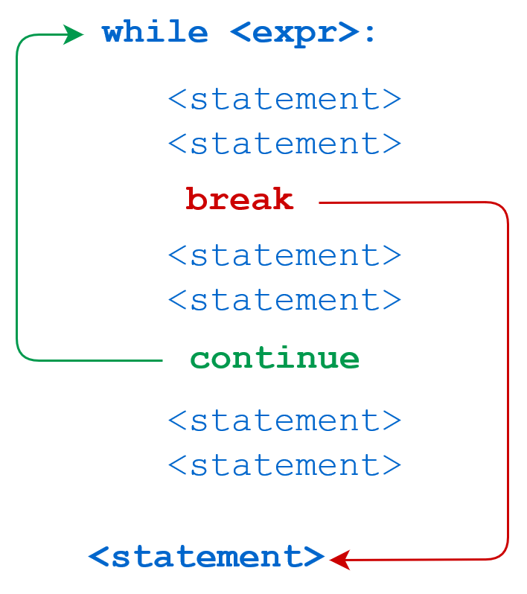
continue / break
continue – skip the current loop and return to condition line of the loop
break – exit the loop entirely

Slide 19
Let’s try together
Write a for loop that prints out uneven numbers between 5 and 55.

